Slide 1


Dept of CSE

Slide 2
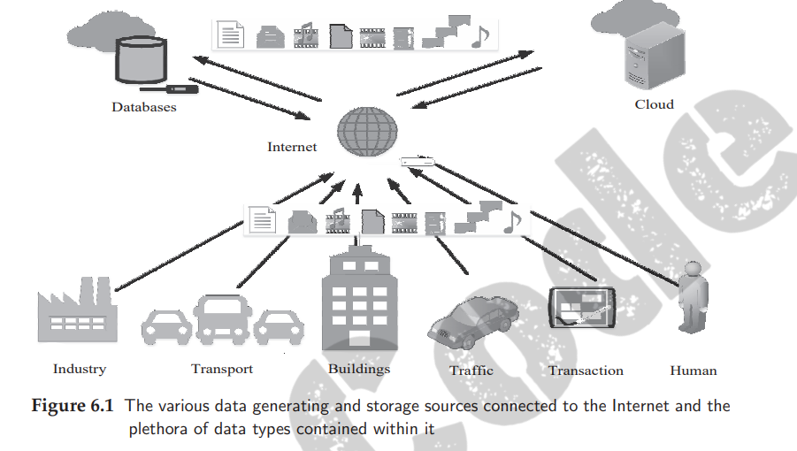
IoT Processing Topologies and Types
The massive volume of data generated by this huge number of users is further enhanced by the multiple devices utilized by most users. In addition to these data-generating sources, non-human data generation sources such as sensor nodes and automated monitoring systems further add to the data load on the Internet
Dept of CSE

Slide 3
Data can be broadly grouped into two types based on how they can be accessed and stored:
Structured data and
Unstructured data
Structured data are associated with relational database management systems (RDBMS). These are primarily created by using length-limited data fields such as phone numbers, social security numbers, and other such information
Dept of CSE
These data types have no pre-defined structure and can vary according to applications and data-generating sources. Some of the common examples of human-generated unstructured data include text, e-mails, videos, images

Slide 4
Importance of Processing in IoT
This necessity has become even more crucial with the rapid advancements in IoT, which is laying enormous pressure on the existing network infrastructure globally
Very time critical, - Data from sources such as flight control systems. very low threshold of processing latency, typically in the range of a few milliseconds
Time critical
sources such as vehicles, traffic, machine systems, smart home systems, surveillance systems, and others, which can tolerate a latency of a few seconds fall in this category
3) Normal.
data-sensitive domains such as agriculture, environmental monitoring, and others
Dept of CSE

Slide 5
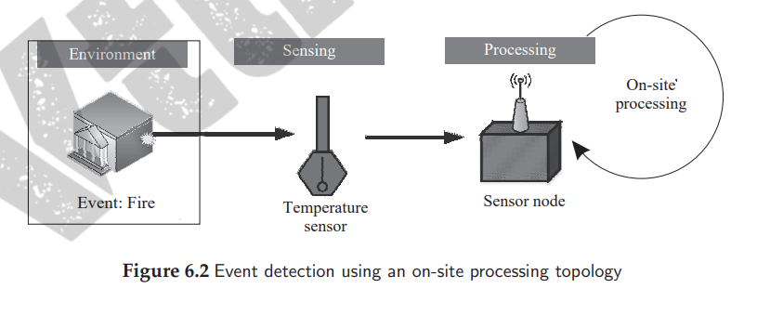
Processing Topologies
1.On-site processing
As evident from the name, the on-site processing topology signifies that the data is processed at the source itself. This is crucial in applications that have a very low tolerance for latencies.
Dept of CSE

Slide 6
2.Off-site processing
The off-site processing paradigm, as opposed to the on-site processing paradigms, allows for latencies (due to processing or network latencies); it is significantly cheaper than on-site processing topologies
In the off-site topology, the data from these sensor nodes (data generating sources) is transmitted either to a remote location (which can either be a server or a cloud) or to multiple processing nodes
Dept of CSE

Slide 7
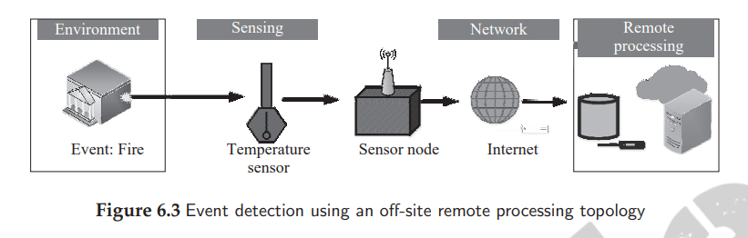
2.1.Remote processing
This is one of the most common processing topologies prevalent in present-day IoT solutions. It encompasses sensing of data by various sensor nodes; the data is then forwarded to a remote server or a cloud-based infrastructure for further processing and analytics
Dept of CSE

Slide 8
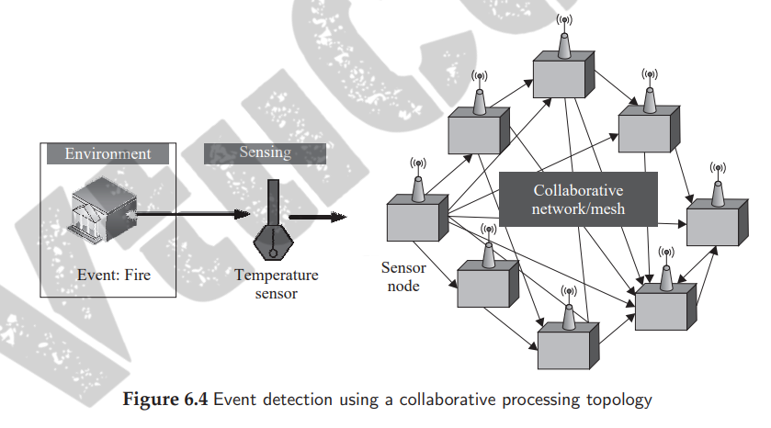
2.2 Collaborative processing
This processing topology typically finds use in scenarios with limited or no network connectivity, especially systems lacking a backbone network. Additionally, this topology can be quite economical for large-scale deployments spread over vast areas, where providing networked access to a remote infrastructure is not viable.
Dept of CSE

Slide 9
IoT Device Design and Selection Considerations
This selection is governed by many parameters that affect the usability, design, and affordability of the designed IoT sensing and processing solution
The main factor governing the IoT device design and selection for various applications is the processor. However, the other important considerations are as follows
Size: This is one of the crucial factors for deciding the form factor and the energy consumption of a sensor node
Dept of CSE
Energy: The energy requirements of a processor is the most important deciding factor in designing IoT-based sensing solutions. Higher the energy requirements, higher is the energy source (battery) replacement frequency.
Cost: The cost of a processor, besides the cost of sensors, is the driving force in deciding the density of deployment of sensor nodes for IoT-based solutions.

Slide 10
Memory: The memory requirements (both volatile and non-volatile memory) of IoT devices determines the capabilities the device can be armed with
Processing power: As covered in earlier sections, processing power is vital (comparable to memory) in deciding what type of sensors can be accommodated with the IoT device/node, and what processing features can integrate on-site with the IoT device
I/O rating: The input–output (I/O) rating of IoT device, primarily the processor, is the deciding factor in determining the circuit complexity, energy usage, and requirements for support of various sensing solutions and sensor types
Dept of CSE
Add-ons: The support of various add-ons a processor or for that matter, an IoT device provides, such as analog to digital conversion (ADC) units, in-built clock circuits, connections to USB and ethernet, inbuilt wireless access capabilities.

Slide 11
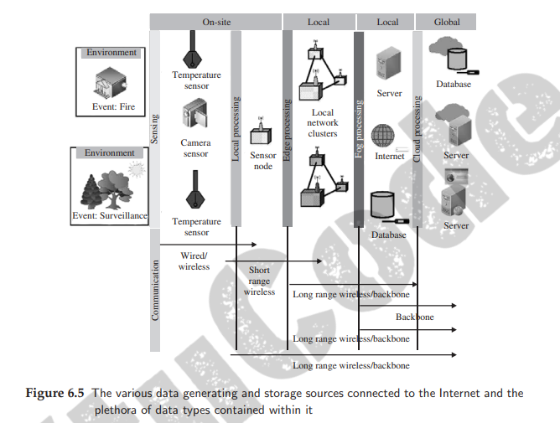
Processing Offloading
Dept of CSE

Slide 12
Processing Offloading
Section on data offloading is divided into three parts:
offload location (which outlines where all the processing can be offloaded in the IoT architecture),
2) offload decision making (how to choose where to offload the processing to and by how much), and finally
3) offloading considerations (deciding when to offload)
Dept of CSE
1.Offload location
Edge
Fog
Remote Server
Cloud

Slide 13
2.Offload decision making
Naive Approach: This approach is typically a hard approach, without too much decision making. It can be considered as a rule-based approach in which the data from IoT devices are offloaded to the nearest location based on the achievement of certain offload criteria
Bargaining based approach
Decision making stages, enables the alleviation of network traffic congestion, enhances service QoS (quality of service) parameters such as bandwidth, latencies, and others. At times, while trying to maximize multiple parameters for the whole IoT implementation, in order to provide the most optimal solution or QoS
Dept of CSE
Learning based approach: Unlike the bargaining based approaches, the learning based approaches generally rely on past behavior and trends of data flow through the IoT architecture. The optimization of QoS parameters is pursued by learning from historical trends and trying to optimize previous solutions further and enhance the collective behavior of the IoT implementation

Slide 14
3.Offloading considerations
Bandwidth: The maximum amount of data that can be simultaneously transmitted over the network between two points is the bandwidth of that network
Latency: It is the time delay incurred between the start and completion of an operation
Criticality: It defines the importance of a task being pursued by an IoT application
Dept of CSE
Resources: It signifies the actual capabilities of an offload location
Data volume: The amount of data generated by a source or sources that can be simultaneously handled by the offload location is referred to as its data volume handling capacity

Slide 15
Dept of CSE

